Slide 1






INTEGRATION PATTERNS IN MODULAR MONOLITH APPLICATIONS
Follow me on Twitter
Halil İbrahim KALKAN
Volosoft, Co-founder
@hibrahimkalkan
@hikalkan

Slide 2
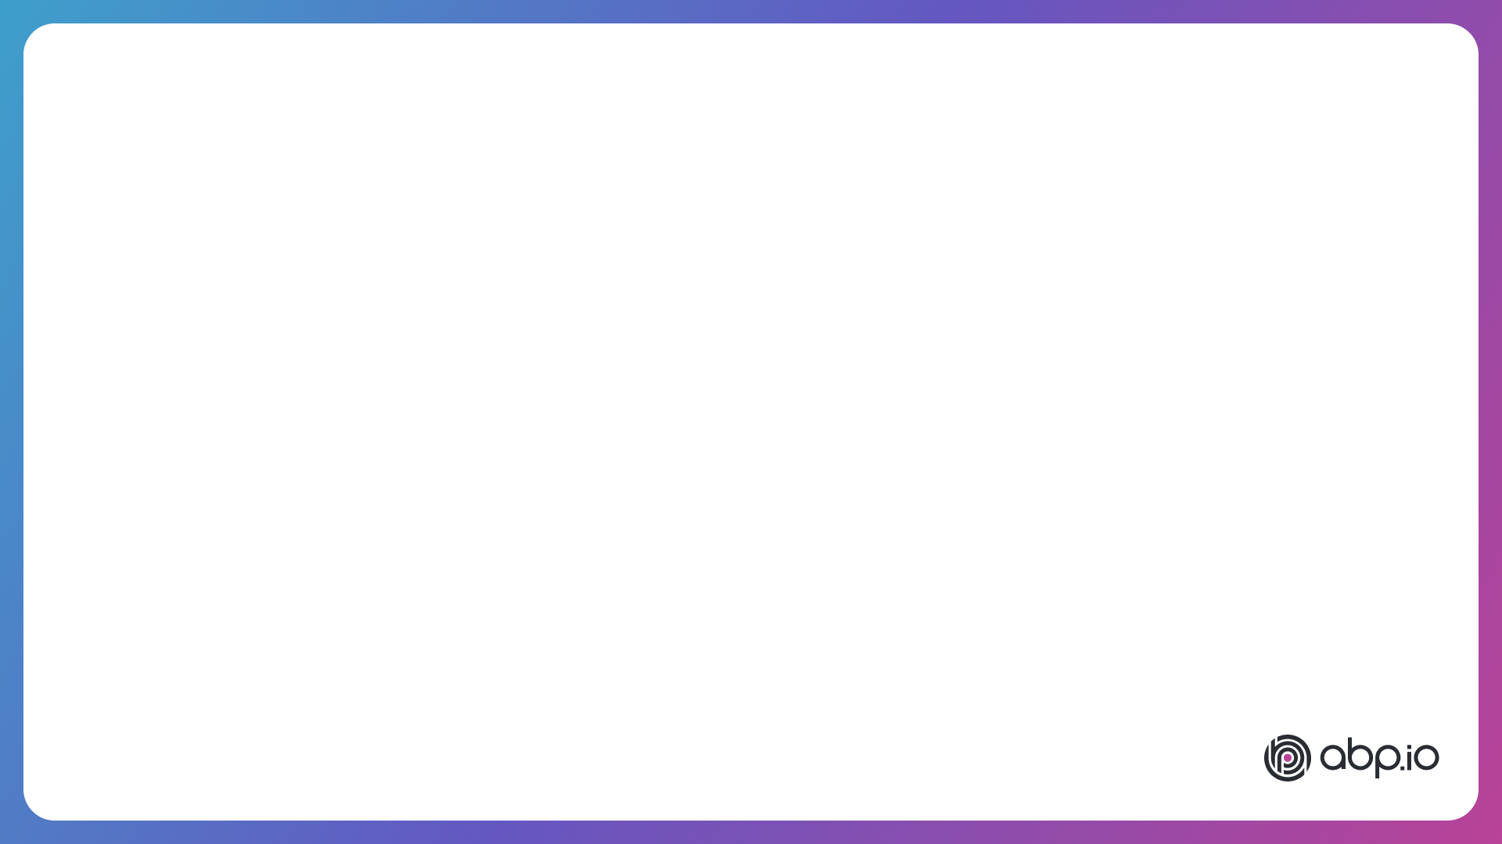
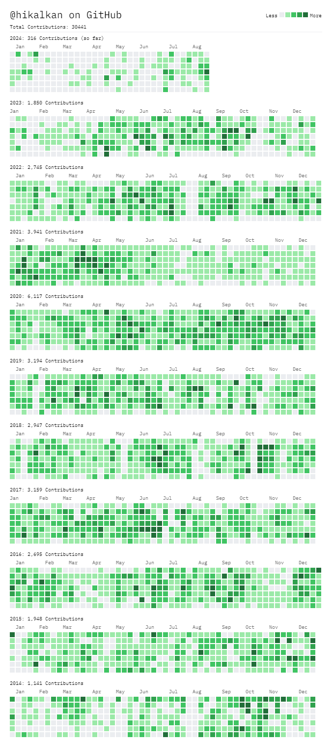







ABOUT ME: HALİL İBRAHİM KALKAN
1997, Started programming (at 14 years old, with Turbo Pascal)
2003-2007, Computer Engineering
2007 - 2015: Software developer, software architect, team leader
2013 - ∞: Lead developer of the open source ABP Framework
2016 - ∞: Co-founder, software architect
Multi-threading, distributed/microservice systems, OOP, DDD, software architectures.. etc.
Still active coder, open-source contributor
30,000+ total contributions on GitHub

Slide 3
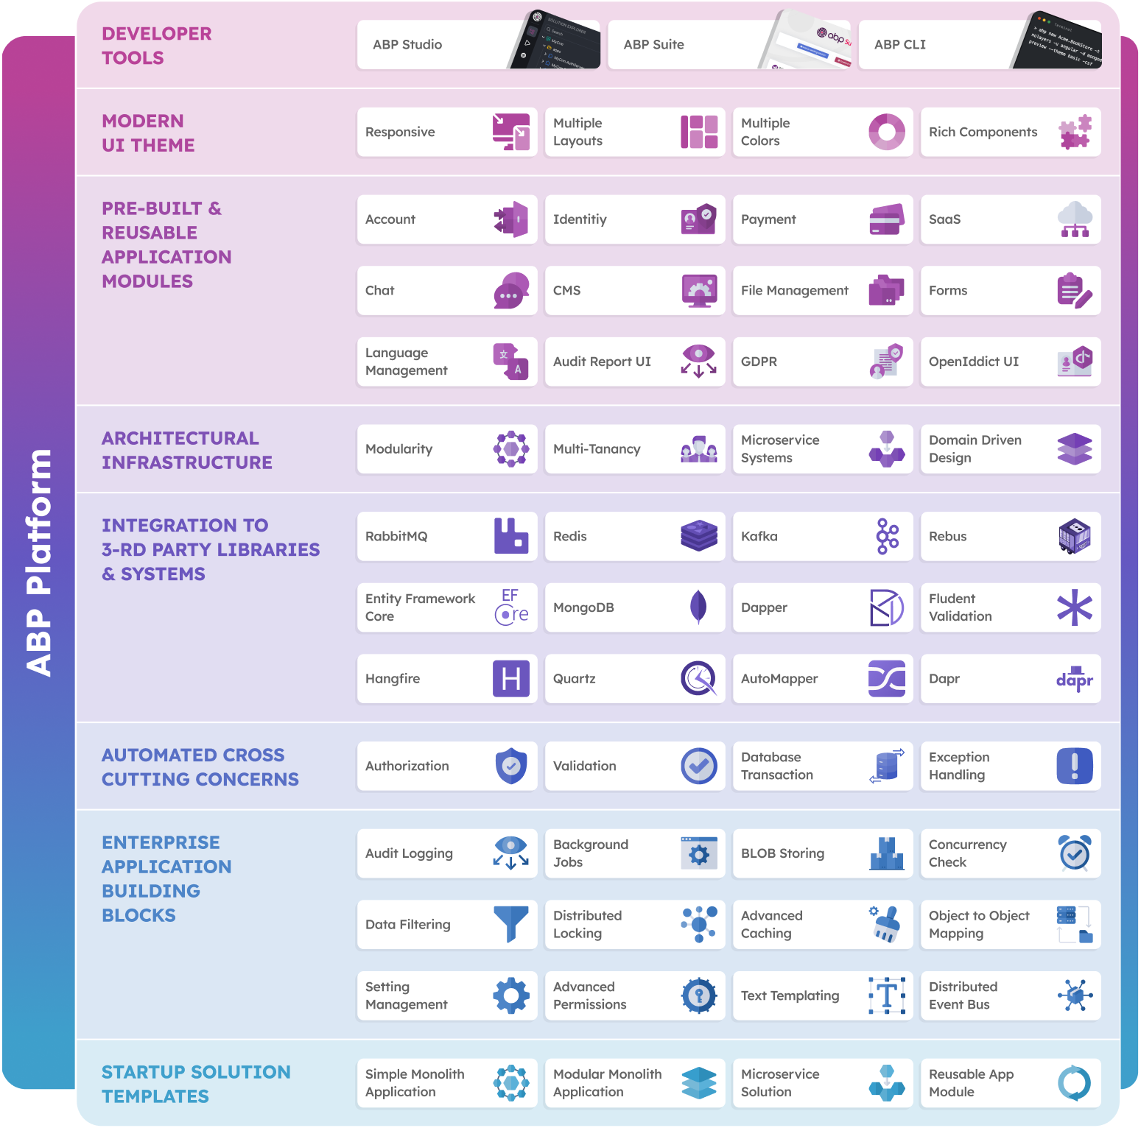
THE ABP PLATFORM
30 Reusable application modules
All modules;
Supports EF Core & MongoDB
Supports MVC, Blazor, Angular UI
Supports modular monolith & microservice scenarios
Supports tiered architecture
Extensible & customizable
Fully layered
Independent of any business
Independent from each other
Good test coverage

Slide 4

AGENDA
Why modularity?
Architectural options - Database - Codebase - User Interface
Integration - Designing module dependencies - Communication types - Transaction management
Specialized modules (utils, common, aggregator, reporting, etc)
Best practices
Migrating to microservices

Slide 5
WHY MODULARITY?
Reducing & managing code complexity
On-premise modular deployment
Migrating to microservices later

Slide 6
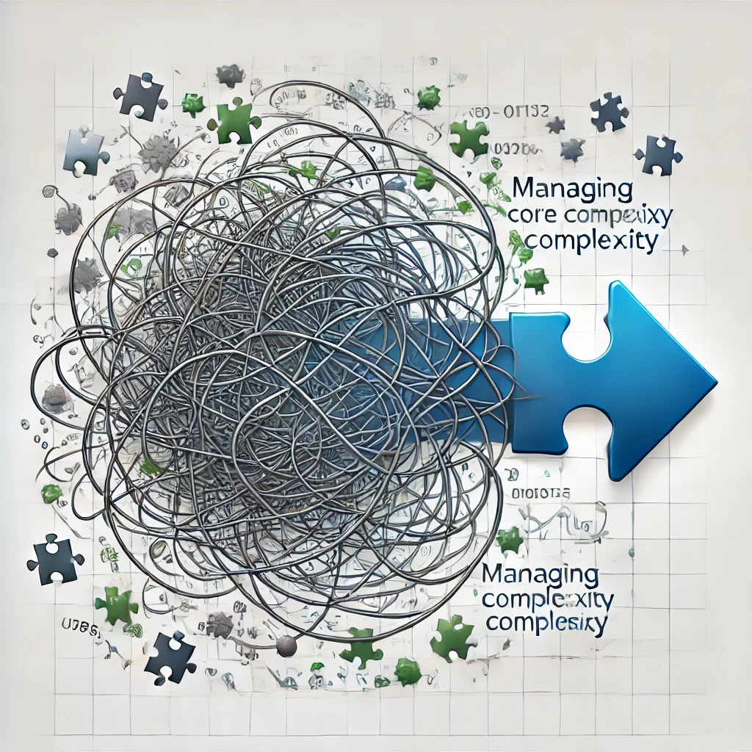
REDUCING AND MANAGING CODE COMPLEXITY
When you have - A large system with multiple sub-domains - Multiple teams and developers
Smaller modules compose a large solution - Easier to understand and develop manage individual modules - Easier to find & fix problems (!)
Develop, test and deploy independently

Slide 7
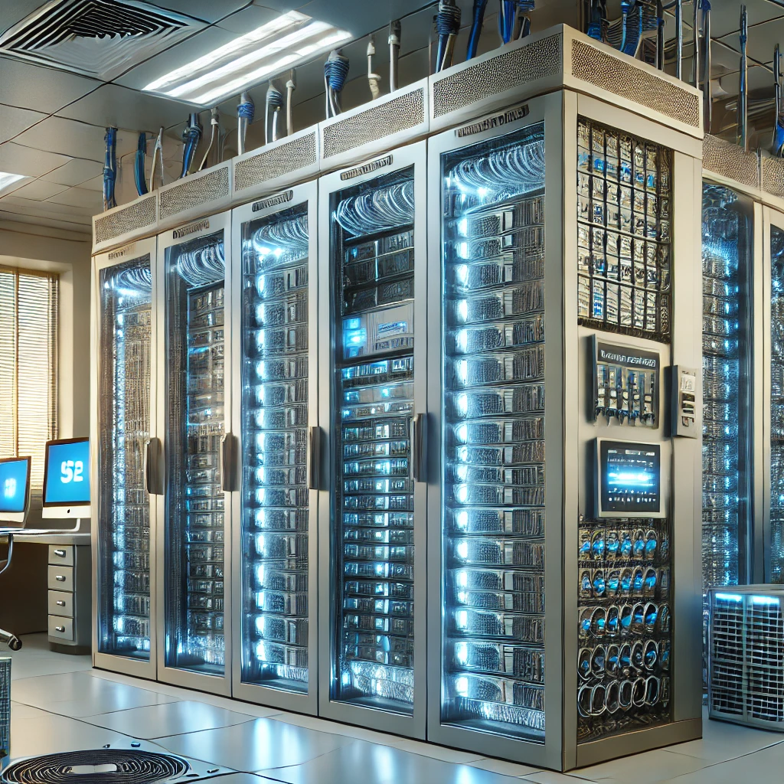
ON-PREMISE MODULAR DEPLOYMENT
Deliver only the modules they have purchased - Requires a completely loose coupled design - The system should work when you remove a module - Can load modules as plug-ins (on application launch time)
Alternative: Enable/disable features on runtime - Obfuscating DLLs

Slide 8
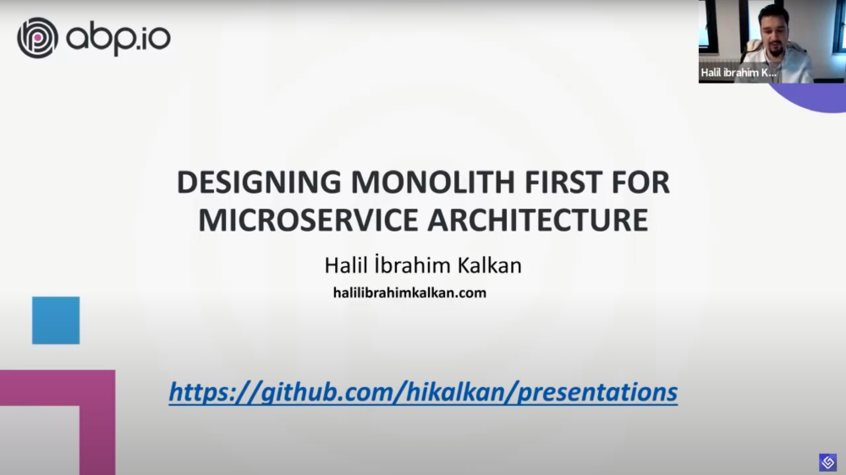


MIGRATING TO MICROSERVICES LATER
Convert modules to services
In-process inter-module communication -> distributed communication - Local method calls -> HTTP API calls - Local events -> Distributed events
Separate databases of modules
Local database transaction -> Distributed transaction
Move the UI out of an API gateway - Design the UI layer as separated
Re-design the authentication flow
Setup development & deployment environments

Slide 9
DATABASE ARCHITECTURE OPTIONS
Use the same physical database - Separate logically with schemas or table prefixes - Use specific connection strings (users) for every module: Enforce isolation - Read all data, manipulate own data - Read-only data access layers - Cons: All modules use the same DBMS technology
Use separate physical databases - Best data isolation - Every module can use the best DBMS technology - Every database can scale independently - More microservice ready - Cons: Hard to prepare multi-module reports
Hybrid - Separate databases only when needed

Slide 10
CODEBASE STRUCTURE
Single codebase - Good for small teams and few modules
Separate codebases - Big teams, too many modules, layered & complex modules - Can be developed in separate Git repositories - May create an umbrella solution
d

Slide 11
TITLE
TODO

Slide 12
TITLE
TODO

Slide 13
TITLE
TODO

Slide 14
TITLE
TODO

Slide 15
TITLE
TODO

Slide 16
TITLE
TODO

Slide 17
TITLE
TODO

Slide 18


Download This Presentation
THANK FOR
WATCHING
Halil İbrahim KALKAN
Volosoft, Co-founder
@hibrahimkalkan
@hikalkan

